Slide 1
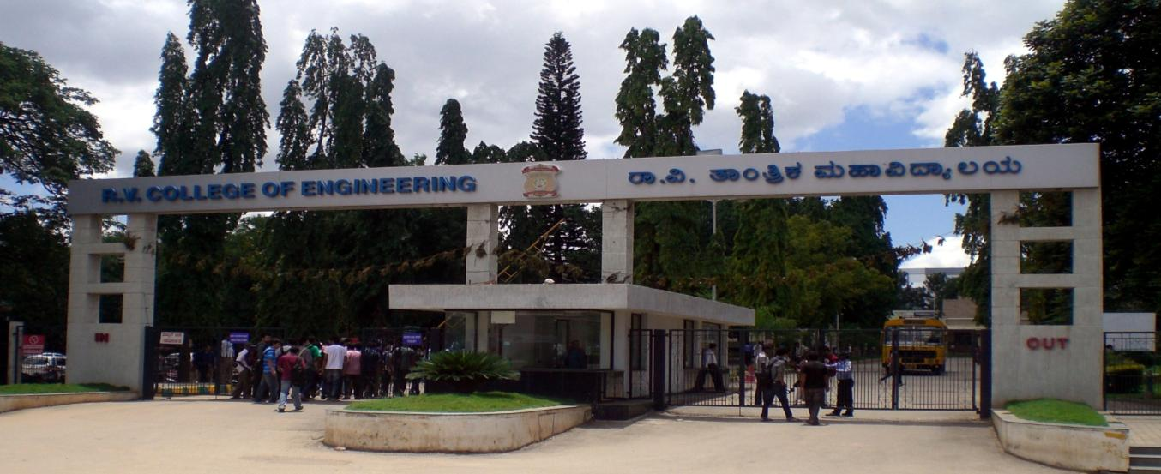
VIII Semester Major Project Work (12CS81)
Department of Computer Science,
R V College of Engineering, Bengaluru.

Slide 2
CCTV Video Summarization in Urban Environments
A.S. Karthik 1RV15CS001
Abhishek Krishna 1RV15CS007
Gagan Deep G 1RV15CS053
Phase-3
Internal Guide : Dr Ramakanth Kumar P (Professor and HoD CSE)

Slide 3
Incorporation of suggestions
Expanded Literature Survey
Clarified Synopsis
Updated UML Diagrams
Tried Different Optimisation Techniques

Slide 4
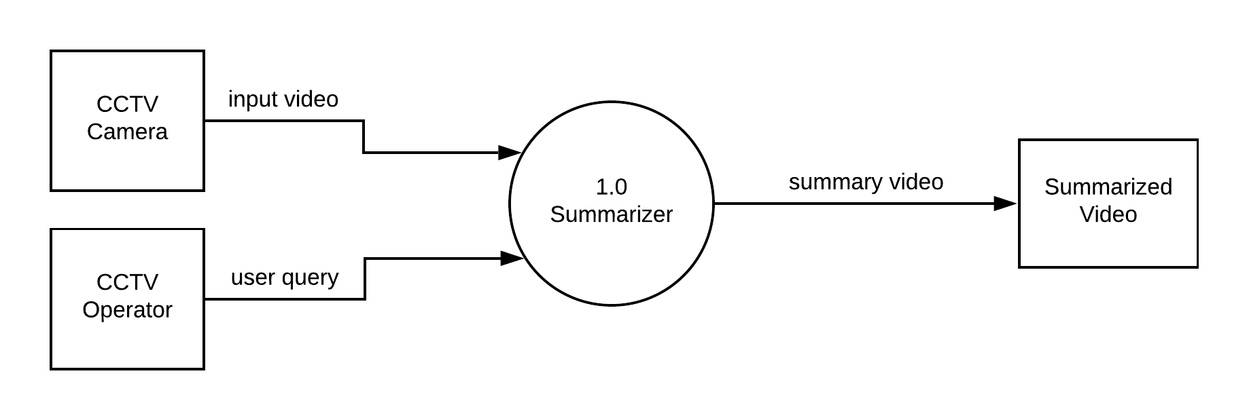
High Level Design (DFD)
Level-0

Slide 5
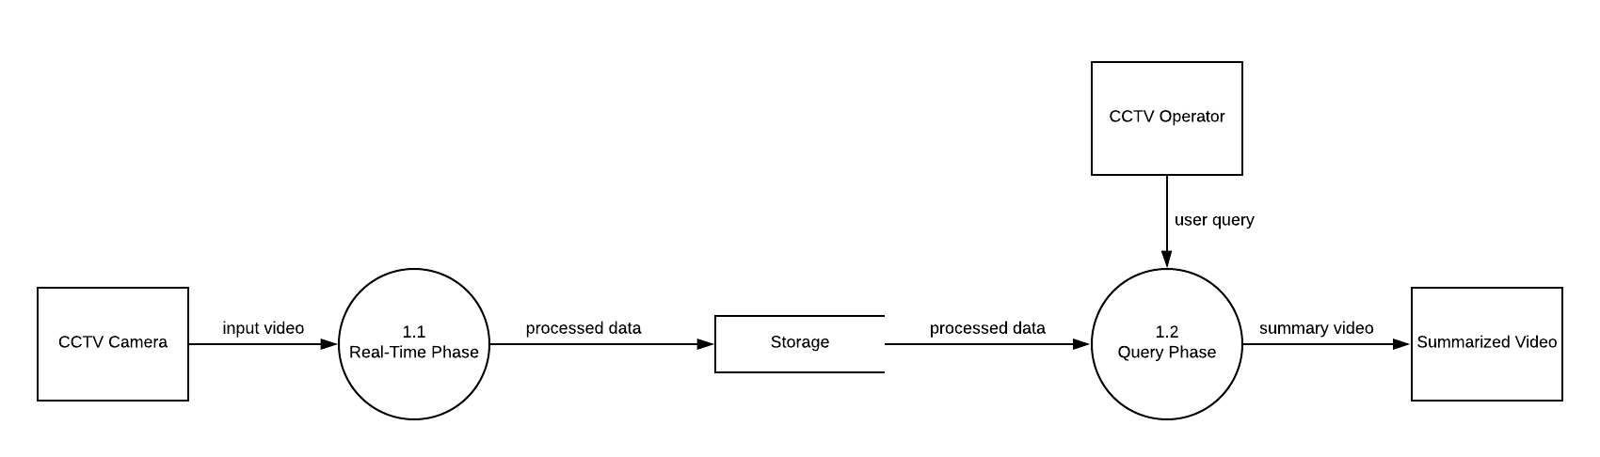
Level-1

Slide 6
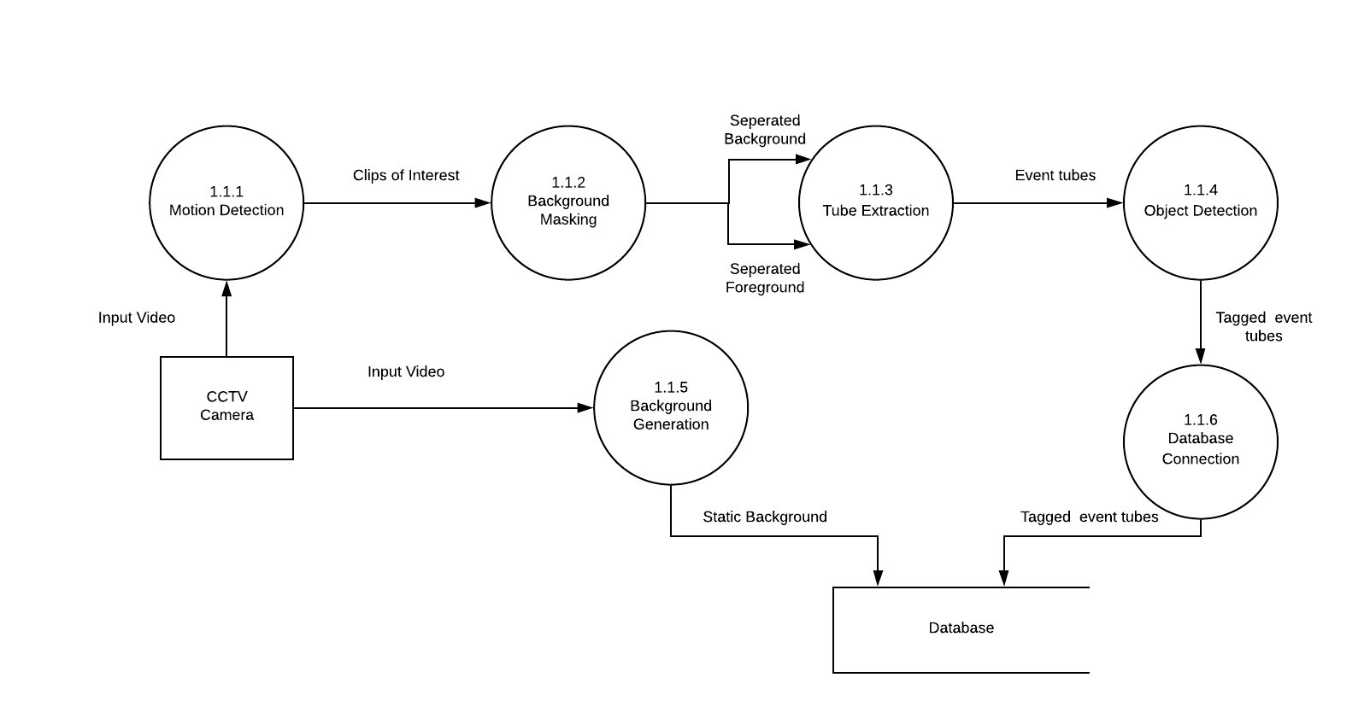
Level-2 (Real-Time Phase)

Slide 7
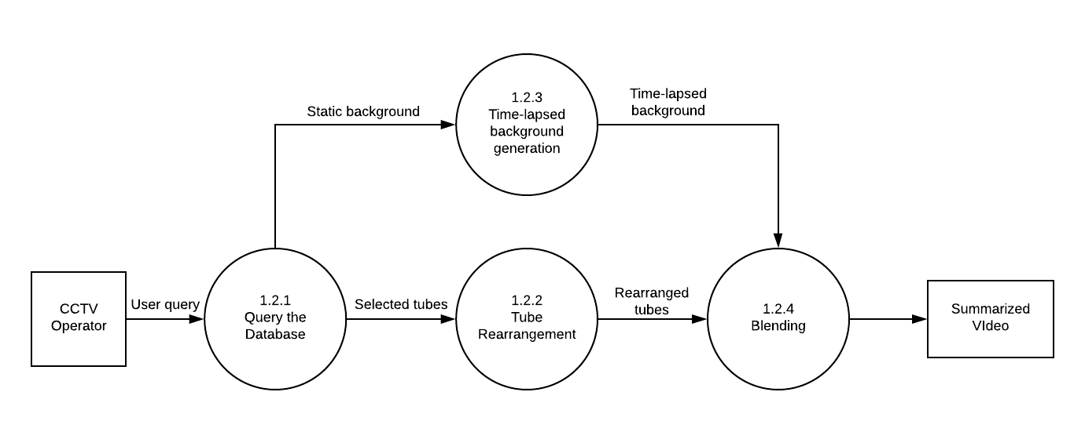
Level-2 (Query Phase)

Slide 8
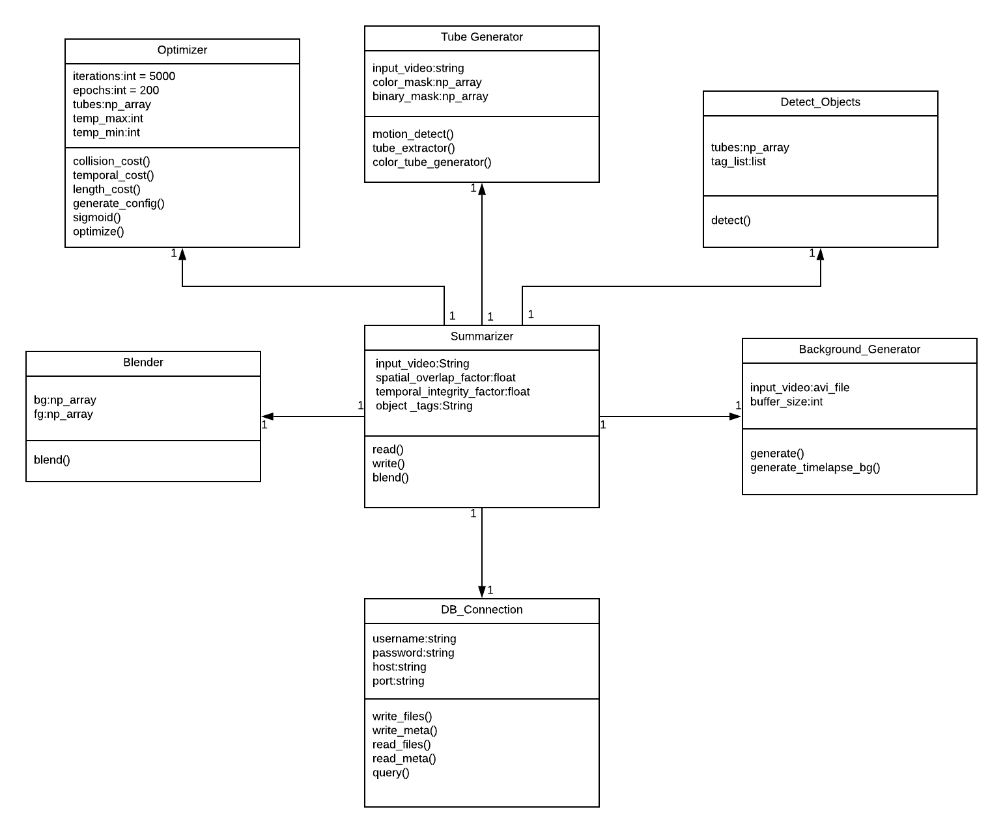
Low Level (UML Class Diagram)

Slide 9
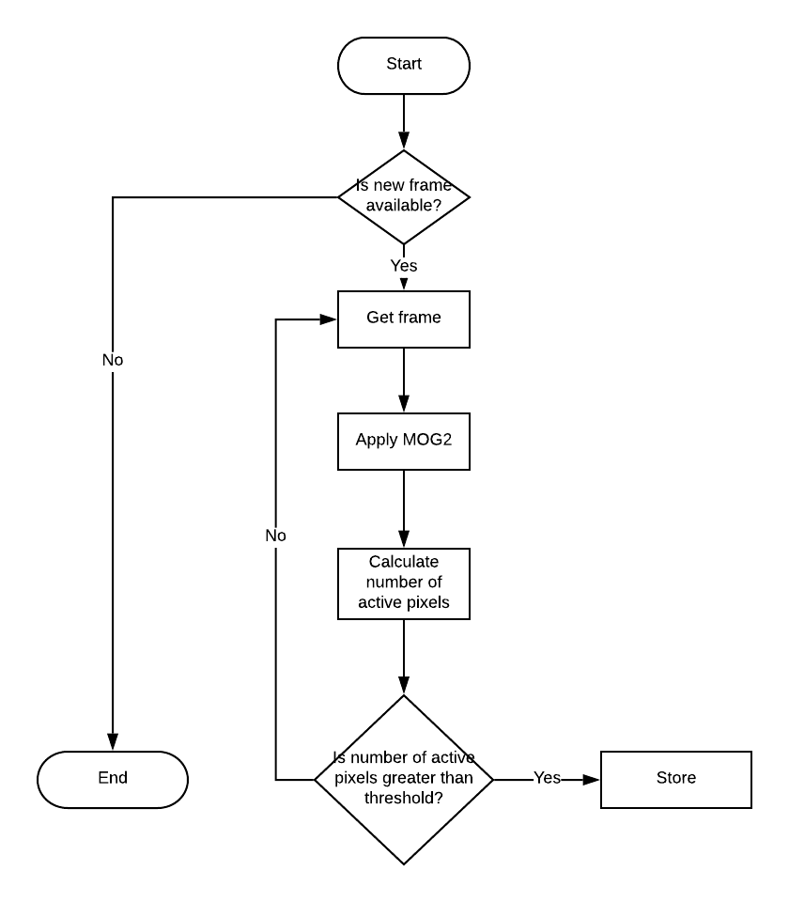
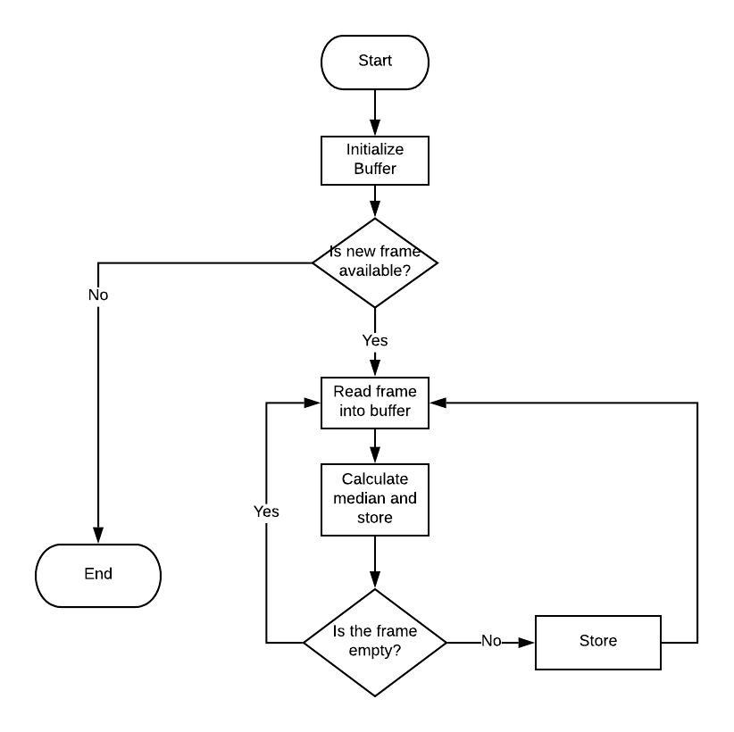
Low Level (Flowcharts)
Background Creation
Motion Detect

Slide 10
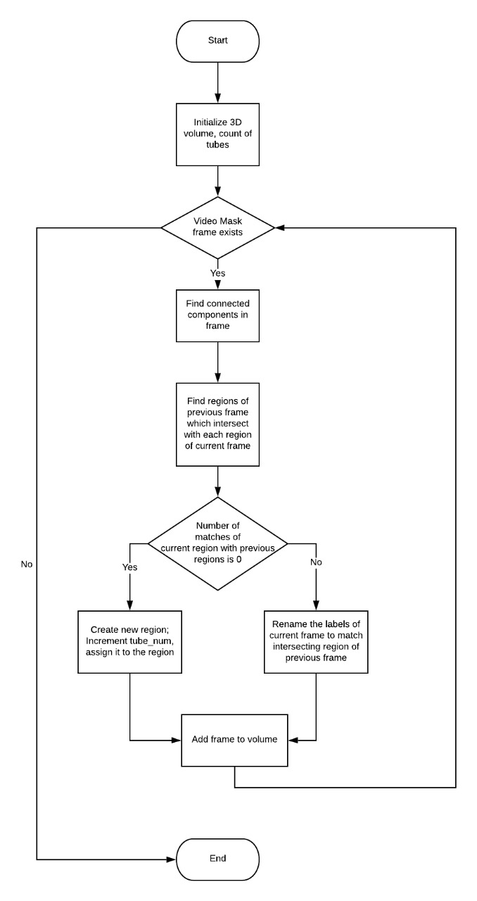
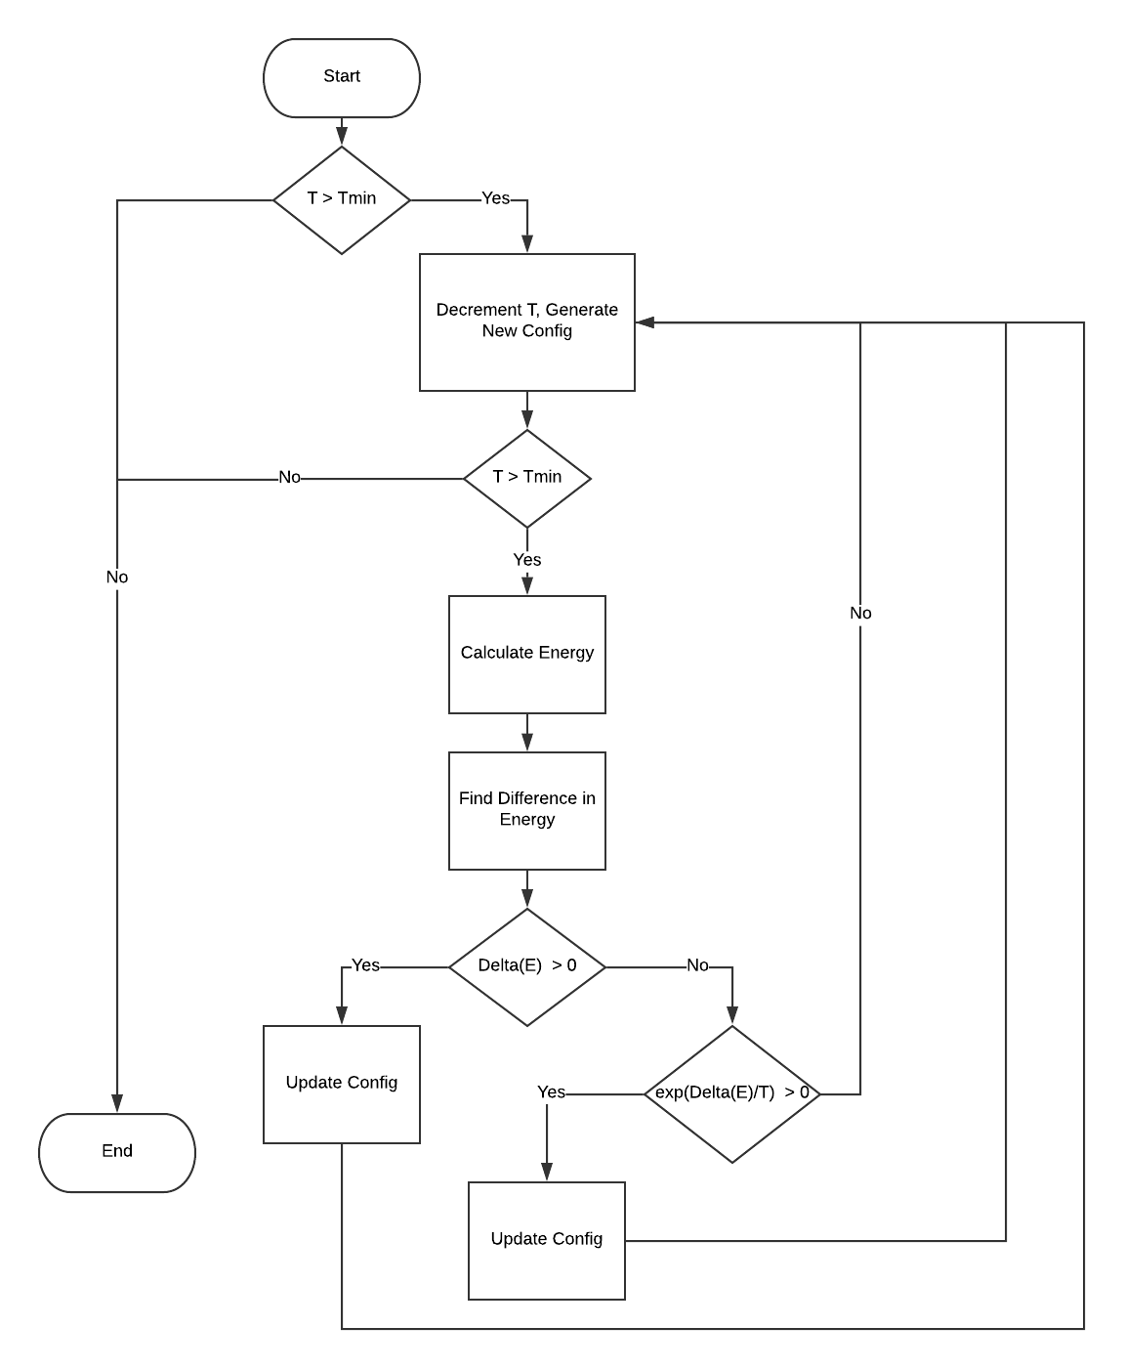
Tube Extraction
Simulated Annealing

Slide 11
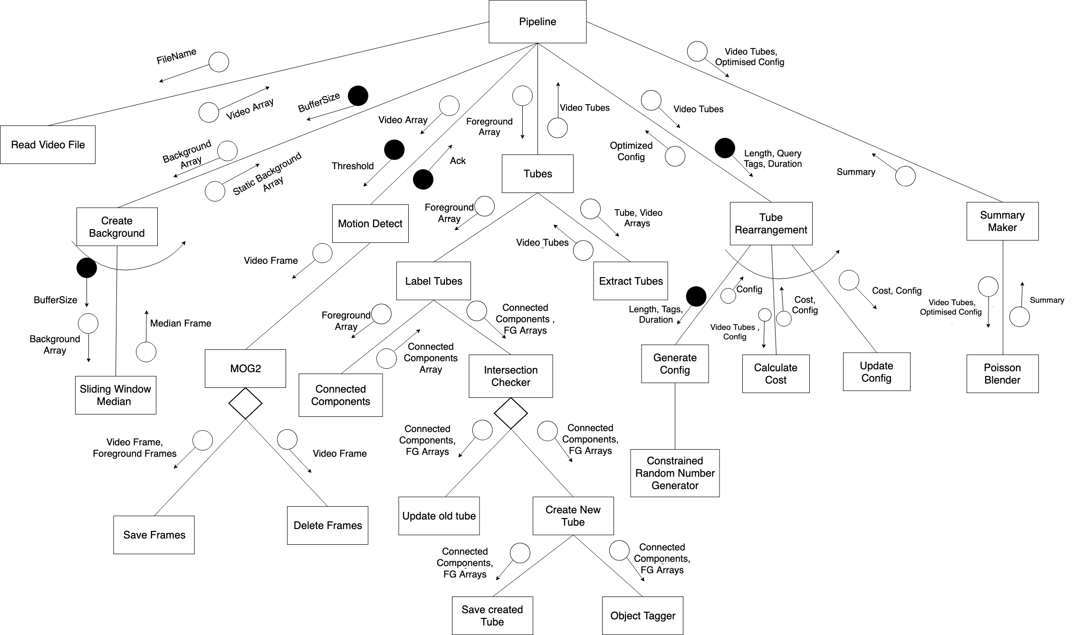
Low Level (Structure Chart)

Slide 12
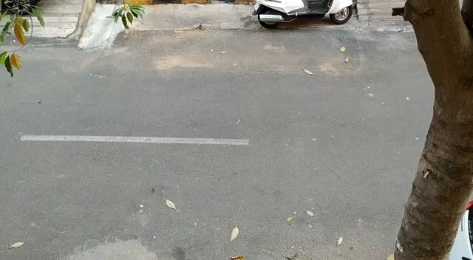
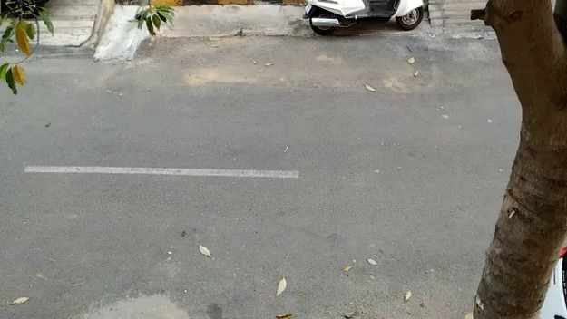
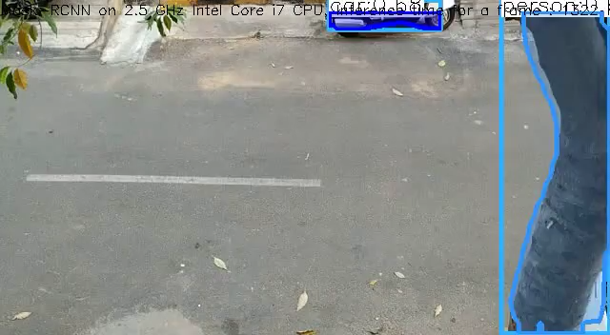
Partial Implementation
Original Video
Summarized Video
Object Tagged Video

Slide 13
References
Redmon, Joseph, et al. "You only look once: Unified, real-time object detection." Proceedings of the IEEE conference on computer vision and pattern recognition. 2016.
Rodriguez, Mikel. "CRAM: Compact representation of actions in movies." 2010 IEEE Computer Society Conference on Computer Vision and Pattern Recognition. IEEE, 2010.
Zivkovic, Zoran, and Ferdinand Van Der Heijden. "Efficient adaptive density estimation per image pixel for the task of background subtraction." Pattern recognition letters 27.7 (2006): 773-780.
Pritch, Yael, et al. "Webcam synopsis: Peeking around the world." 2007 IEEE 11th International Conference on Computer Vision. IEEE, 2007.
Rav-Acha, Alex, Yael Pritch, and Shmuel Peleg. "Making a long video short: Dynamic video synopsis." 2006 IEEE Computer Society Conference on Computer Vision and Pattern Recognition (CVPR'06). Vol. 1. IEEE, 2006.
Pritch, Yael, Alex Rav-Acha, and Shmuel Peleg. "Nonchronological video synopsis and indexing." IEEE transactions on pattern analysis and machine intelligence30.11 (2008): 1971-1984.

